Slide 1
Introduction to Coding
Both names and affiliations, or just individual? Up to you

Slide 2
This Session
Once you have finished building your base robot, it is time to talk about sensors and code.

Slide 3
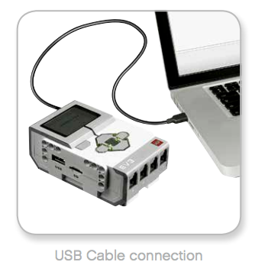
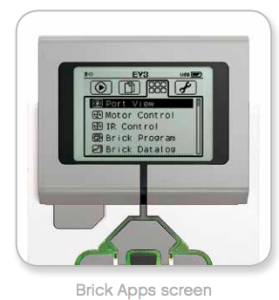
Coding 1
There are two ways you can code the robot – either on the brick, or through your desktop machines.

Slide 4
Brick Coding
Coding on the brick means you can program your robot without the need for a PC –
But you are limited to a small, monochrome display which can make intricate programming more difficult.

Slide 5
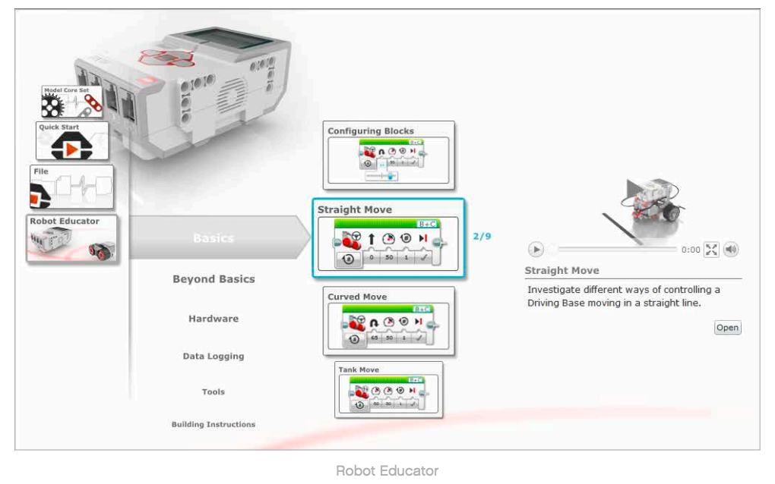
Desktop Coding
Open the EV3 software at x
Navigate to y

Slide 6
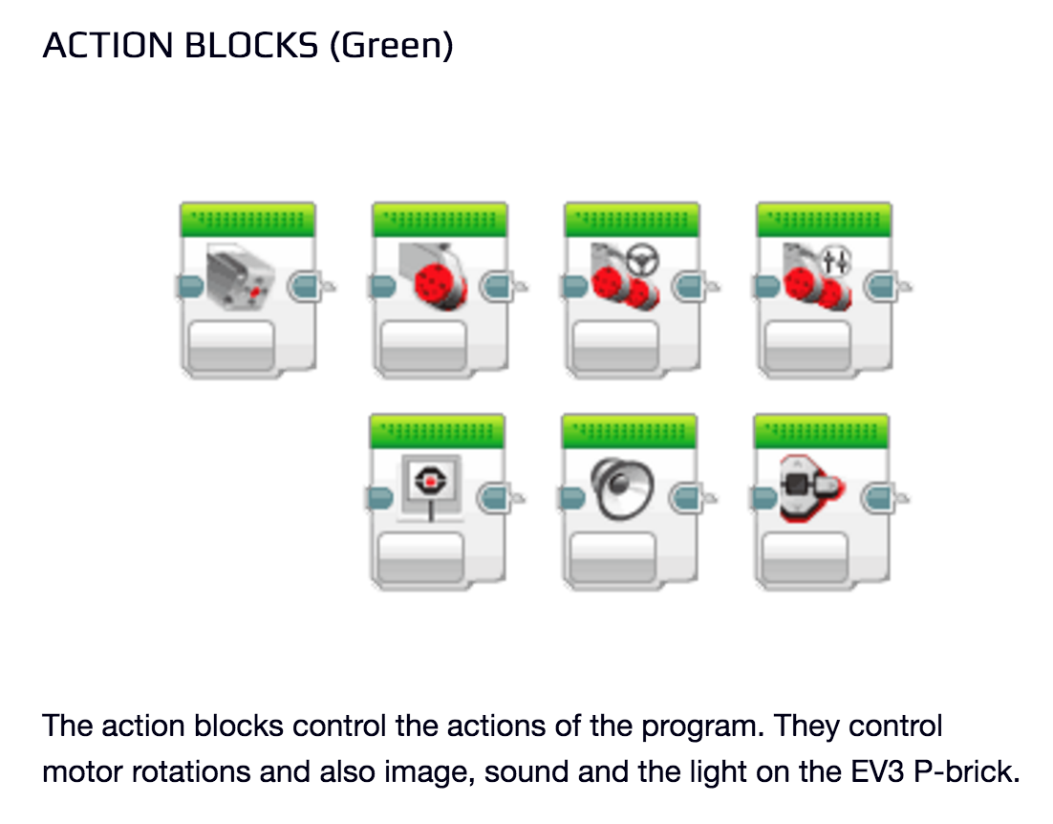
Desktop Coding

Slide 7
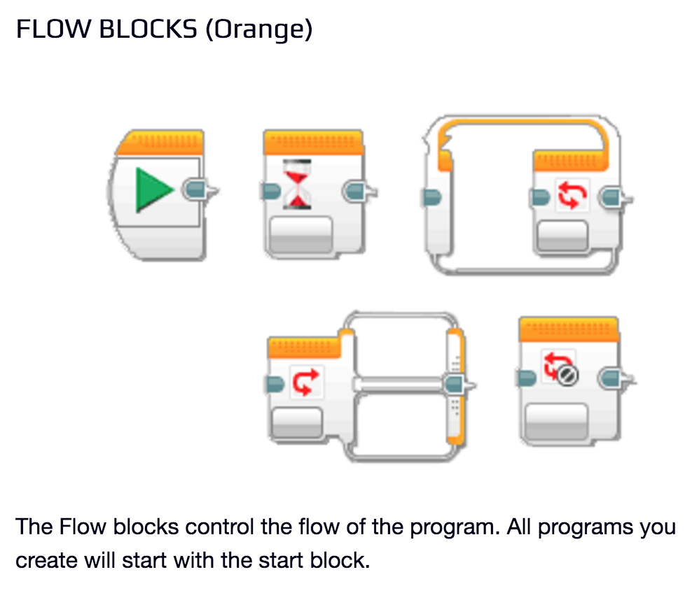
Desktop Coding

Slide 8
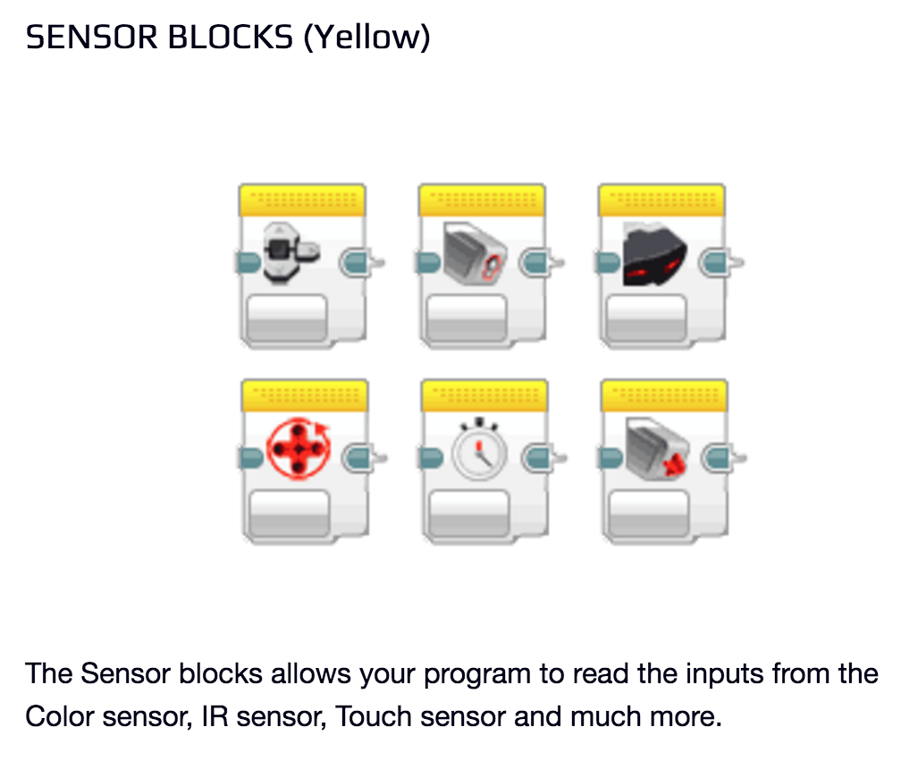
Desktop Coding

Slide 9
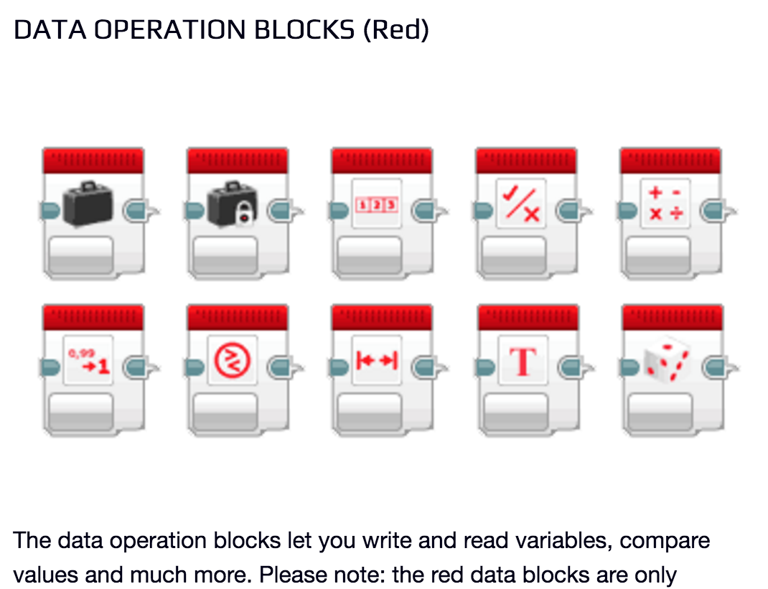
Desktop Coding

Slide 10
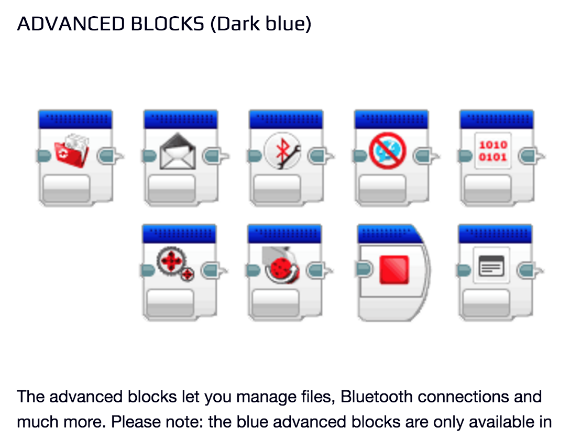
Desktop Coding

Slide 11
Live Demo
Further material is available on Moodle (EV3 User Guide.pdf)

Slide 12
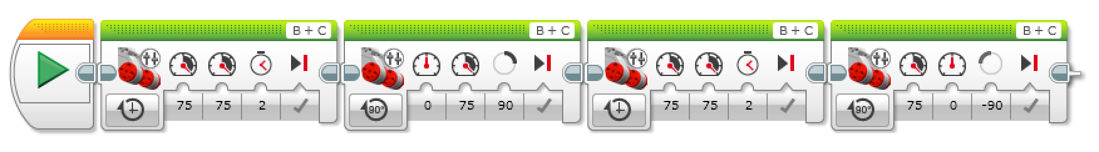
Task 1
Follow the instructions (brick/desktop) and run the program.
What does the robot do?

Slide 13
Looking Ahead
We have the choice of a number of sensors to enhance our robot’s capabilities.
You will need to research and find out how to connect and work these sensors in order to complete the challenge at the end of week 4.
As an example, let’s look at the ultrasonic sensor.

Slide 14
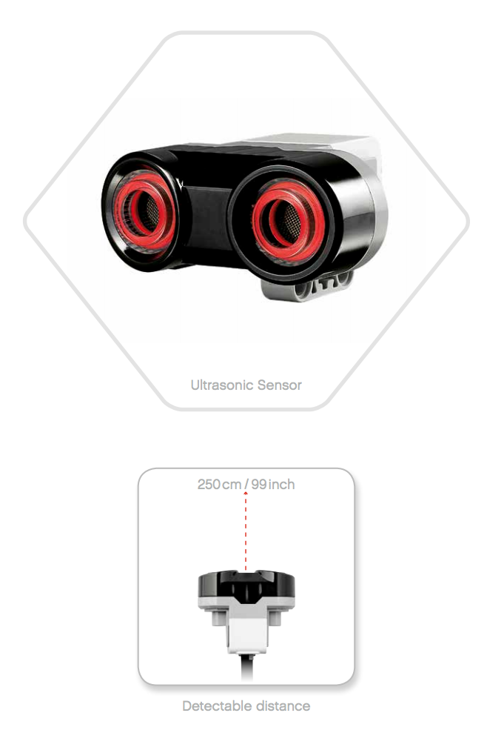
Ultrasonic Sensor
This allows the robot to ‘see’.
Let’s connect one to our robot.
Follow the instructions on build_robot eyes.pdf

Slide 15
Task 2
Using the eyes, can you solve this challenge?
Go forward
When you see an object less than 30cm from you…
Stop.
ALREADY FINISHED?
Go forward until you see something, then turn 90 degrees to the right and repeat…

Slide 16
What’s Next?
In the next session, we will discuss the robot competition and walk through each of the challenges you will be attempting.
By now, you should have at least a complete base robot, and an understanding of how to use the available sensors.
From this point on, it is up to you to decide how to move forward.

Slide 17
